Slide 1
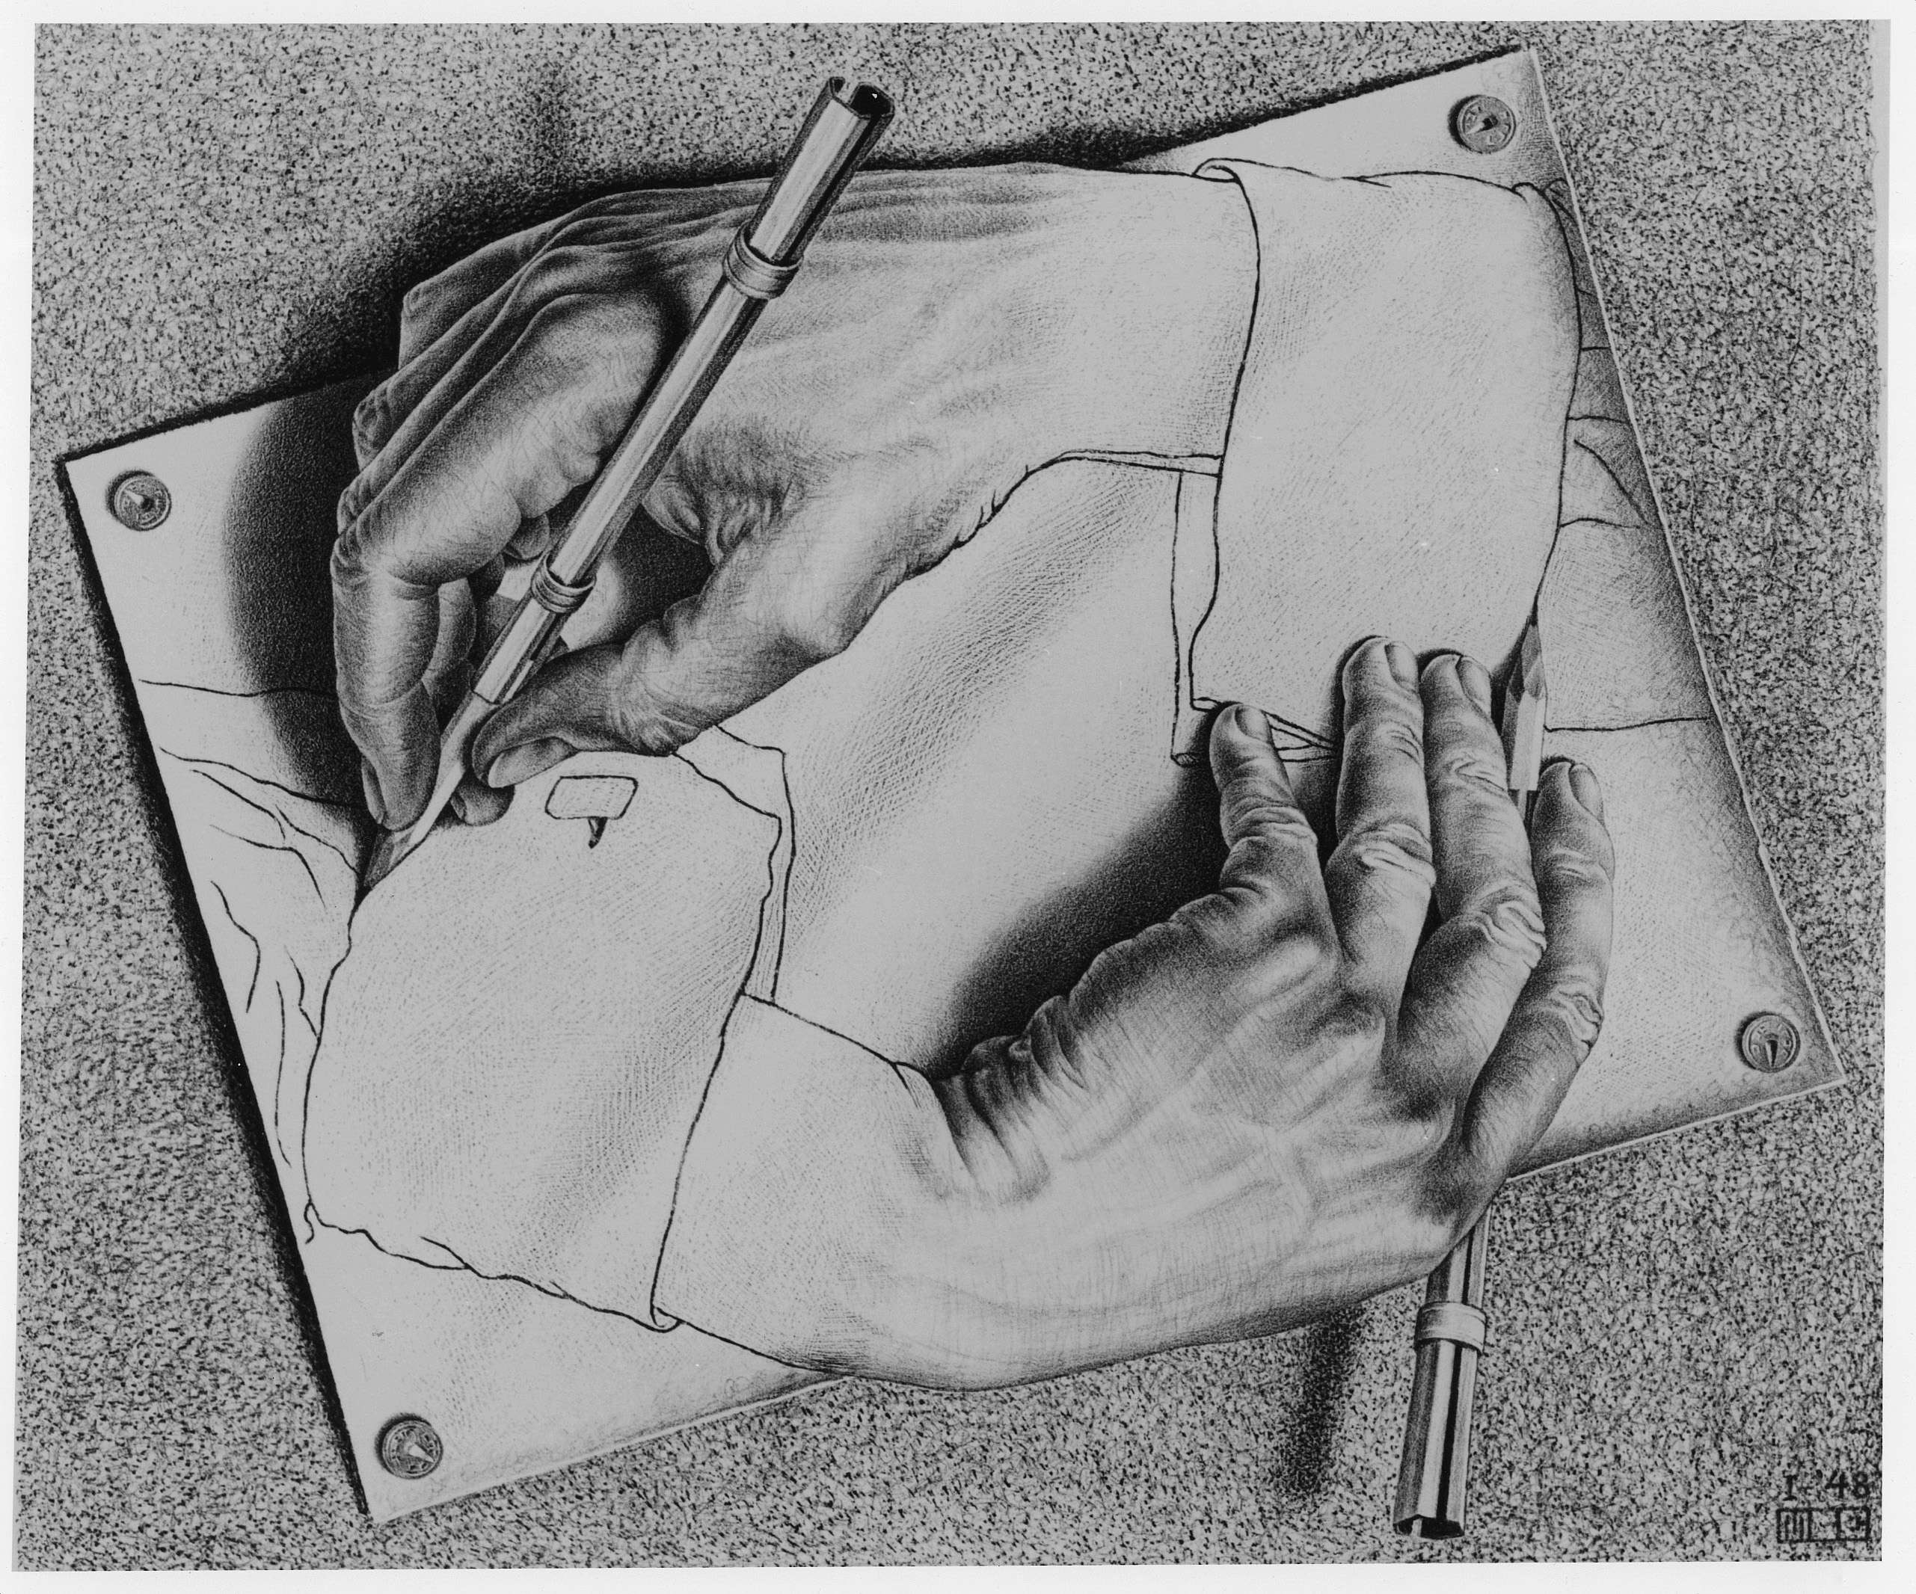
Recursion
M. C. Escher : Drawing Hands

Slide 2
The Recursive Process
Recursive solutions involve two major parts:
Base case(s), the problem is simple enough to be solved directly
Recursive case(s). A recursive case has three components:
Divide the problem into one or more simpler or smaller parts
Invoke the function (recursively) on each part, and
Combine the solutions of the parts into a solution for the problem.

Slide 3
Why learn recursion?
Recursive data is all around us!
Take CS61B (data structures), CS70 (discrete math), CS164 (Programming Languages), Data 101 (Data Eng) for more examples where you'll encounter recursion
Trees (post-midterm) and Graphs are structures which are recursive in nature.
E.g. A social network is a graph of friends with connections to other friends, with connections to other friends.
Analyzing "chains" of data, can benefit from recursion
Next Lecture: Problems that "branch" out:
generating subsets and permutations
calculating Fibonacci numbers

Slide 4
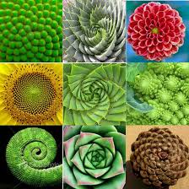
Palindromes

Slide 5
Learning Objectives
Compare Recursion and Iteration to each other
Translate some simple functions from one method to another
Write a recursive function
Understand the base case and a recursive case

Slide 6
Palindromes
Palindromes are the same word forwards and backwards.
Python has some tricks, but how could we build this?
palindrome = lambda w: w == w[::-1]
[::-1] is a slicing shortcut [0:len(w):-1] to reverse items.
Let's write Reverse:
def reverse(s):
result = ''
for letter in s:
result = letter + result
return result
def reverse_while(s):
"""
>>> reverse_while('hello')
'olleh'
"""
result = ''
while s:
first = s[0]
s = s[1:] # remove the first letter
result = first + result
return result

Slide 7
Fun Palindromes
C88C
racecar
LOL
radar
a man a plan a canal panama
aibohphobia 😈
The fear of palindromes.
https://czechtheworld.com/best-palindromes/#palindrome-words

Slide 8
Writing Reverse Recursively
def reverse(s):
if not s:
return ''
return 'TODO'
def palindrome(word):
return word == reverse(word)

Slide 9
How should reverse work?
Our algorithm in words:
Take the first letter, put it at the end
The beginning of the string is the reverse of the rest.
reverse('ABC')
→ reverse('BC') + 'A'
→ reverse('C') + 'B' + 'A
→ 'C' + 'B' + 'A
→ 'CBA'

Slide 10
reverse recursive
def reverse(s):
if not s:
return ''
return reverse(s[1:]) + s[0]
def palindrome(word):
return word == reverse(word)
Recursive Case

Slide 11
Palindrome – Alternative Approaches
Compare first / last letters, working our way towards the middle
Base Case?
What is the smallest word that is a palindrome?
A 1-letter word!
A 0 letter word? Maybe?
We can have a recursive case:
If the first and last letter are the same, check the "inner word"
If they're not → return False

Slide 12
Summing Numbers
Combining Return Values

Slide 13
Iteration vs Recursion: Sum Numbers
While loop:
For loop:
def sum(n):
total = 0
i = 0
while i < n:
i += 1
total += i
return total
def sum(n):
total = 0
for i in range(0, n+1):
total += i
return total

Slide 14
Recursively Sum Number
What is the base case?
What is the smallest number that we can sum to?
If so, what is the result?
def sum(n):
if n == 0:
return 0

Slide 15
Recursively Sum Numbers
Recursion:
def sum(n):
if n == 0:
return 0
return n + sum(n-1)

Slide 16
Iteration vs Recursion: Cheating!
Sometimes it’s best to just use a formula! But that’s not always the point. ☺
def sum(n):
return (n * (n + 1)) / 2

Slide 17
Review: Functions
def <function name> (<argument list>) :
expression
return
def concat(str1, str2):
return str1+str2;
concat(“Hello”,”World”)
Generalizes an expression or set of statements to apply to lots of instances of the problem
A function should do one thing well

Slide 18
How does it work?
Each recursive call gets its own local variables
Just like any other function call
Computes its result (possibly using additional calls)
Just like any other function call
Returns its result and returns control to its caller
Just like any other function call
The function that is called happens to be itself
Called on a simpler problem
Eventually stops on the simple base case

Slide 19
Recursion With Lists

Slide 20
Another Example – Finding a Minimum
indexing an element of a sequence
def first(s):
"""Return the first element in a sequence."""
return s[0]
def rest(s):
"""Return all elements in a sequence after the first"""
return s[1:]
def min_r(s):
"""Return minimum value in a sequence."""
if len(s) == 1:
return first(s)
else:
return min(first(s), min_r(rest(s)))
Slicing a sequence of elements
Base Case
Recursive Case
Recursion over sequence length

Slide 21
Understanding Order of Execution

Slide 22
Recall: Iteration
1. Initialize the “base” case of no iterations
2. Starting value
def sum_of_squares(n):
accum = 0
for i in range(1,n+1):
accum = accum + i*i
return accum
3. Ending value
4. New loop variable value

Slide 23
Recursion Key concepts – by example
1. Test for simple “base” case
2. Solution in simple “base” case
def sum_of_squares(n):
if n < 1:
return 0
else:
return sum_of_squares(n-1) + n**2
3. Assume recusive solution to simpler problem
4. ”Combine” the simpler part of the solution, with the recursive case

Slide 24
In words
The sum of no numbers is zero
The sum of 1² through n² is the
sum of 1² through (n-1⁾²
plus n²
def sum_of_squares(n):
if n < 1:
return 0
else:
return sum_of_squares(n-1) + n**2

Slide 25
Why does it work
sum_of_squares(3)
# sum_of_squares(3) => sum_of_squares(2) + 3**2
# => sum_of_squares(1) + 2**2 + 3**2
# => sum_of_squares(0) + 1**2 + 2**2 + 3**2
# => 0 + 1**2 + 2**2 + 3**2 = 14

Slide 26
Questions
In what order do we sum the squares ?
How does this compare to iterative approach ?
def sum_of_squares(n):
accum = 0
for i in range(1,n+1):
accum = accum + i*i
return accum
def sum_of_squares(n):
if n < 1:
return 0
else:
return sum_of_squares(n-1) + n**2
def sum_of_squares(n):
if n < 1:
return 0
else:
return n**2 + sum_of_squares(n-1)

Slide 27
Trust …
The recursive “leap of faith” works as long as we hit the base case eventually
What happens if we don’t?

Slide 28
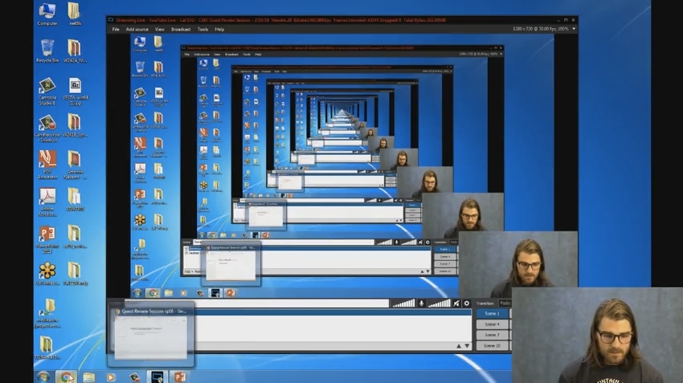
Recursion (unwanted)

Slide 29
Why Recursion?
“After Abstraction, Recursion is probably the 2nd biggest idea in this course”
“It’s tremendously useful when the problem is self-similar”
“It’s no more powerful than iteration, but often leads to more concise & better code”
“It’s more ‘mathematical’”
“It embodies the beauty and joy of computing”
…

Slide 30
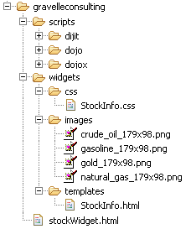
Example I
List all items on your hard disk
Files
Folders contain
Files
Folders
Recursion!

Slide 31
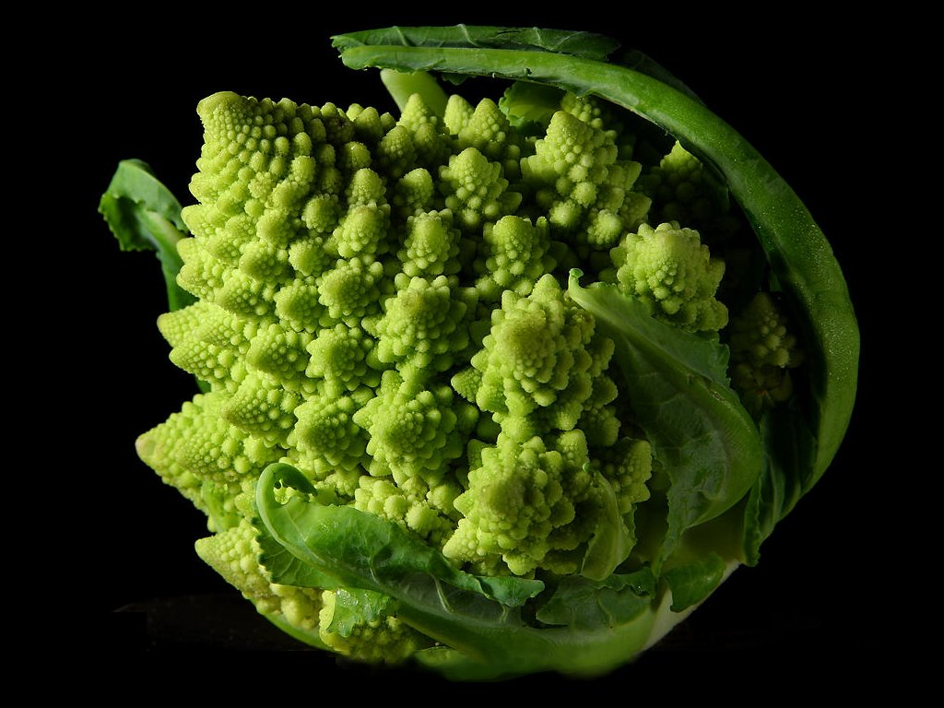
Why Recursion? More Reasons
Recursive structures exist (sometimes hidden) in nature and therefore in data!
It’s mentally and sometimes computationally more efficient to process recursive structures using recursion.

